Slide 1


Automotive Sales Analysis

Slide 2
Table of contents
01
02
03
Project Overview
Technology used
Business-Wide Navigation

Slide 3

01
Project Overview

Slide 4

Project &
strategy definition
The Automotive Sales Analysis project was developed for GB Company with the primary objective of extracting valuable insights from their sales dataset. This comprehensive analysis aims to empower GB Company with data-driven decisions, optimize sales strategies, and enhance overall business performance in the automotive sector.

Slide 5
Deliverables:
The project will culminate in the delivery of:
A comprehensive report summarizing key findings and actionable insights.
Visualizations, graphs, and charts to support the analysis and facilitate understanding.
Recommendations for strategic improvements and potential areas for growth.

Slide 6

02
Technology Used

Slide 7
SQL Analysis

Slide 8
SQL Overview
Prepare datast.
Exploring dataset.
Cleaning dataset [Fill null values, Check for duplicates, Renaming columns, Change dates].
Answering business questions.

Slide 9
SQL Insights and Recommendations
1. Sales by Brand and Model:
The brand with the highest invoice amount is HYNDAI.
The model contributing most to this amount is TUCSON NX4E.
The total amount associated with this combination is $102,281.
2. Top Customers by Order Amount:
Upon running the query for the top customers based on order amount, I found that the top 10 customers all share the same order amount, which is $20.
3. Monthly Invoice Amount Trend:
The Monthly Invoice Amount Trend query provides a comprehensive view of the invoice amounts for each month across different years.
4. Payment Type Distribution:
Analyzing the Payment Type Distribution query reveals that Cash has the highest number of customers, followed by Credit – امر توريد.
5. Average Time for Order Fulfillment:
After executing the Average Time for Order Fulfillment query, it is observed that the average time required for order fulfillment is 406 units.

Slide 10
Python Analysis

Slide 11
Python Overview
Prepare datast.
Exploring dataset.
Cleaning dataset [Fill null values, Check for duplicates, Renaming columns].
Answering business questions.
Ask more SMART question and answering them for providing more insights.

Slide 12
Python Insights and Recommendations
Months 7, 8, and 9 in 2022: No Sales Recorded
Implication: Potential challenges in reaching sales targets.
Discussion Point: Explore reasons and identify strategies for improvement.
Months 10, 11, and 12 in 2014 and 2022: No Sales Recorded
Objective: Investigate historical trends.
Insight: Understanding the circumstances in 2014 can provide valuable insights for our current situation.
Highest Sales Recorded: 2013
Observation: The peak sales occurred in 2013.
Significance: Analyze factors contributing to success and consider replicating successful strategies.
Sales Trends in 2021: Consistent Monthly Performance
Observation: In 2021, sales exhibited a close range for each month.
Implication: A stable sales pattern in 2021 suggests a need to identify and leverage successful practices.

Slide 13
Python Insights and Recommendations
Invoice Amount Distribution: Histogram Analysis
Visualization: Utilize histograms to illustrate the distribution of invoice amounts.
Observation: Invoice amounts closely clustered together.
Implication: Explore factors contributing to the consistent distribution.
Top 3 Transaction Types by Total Sales:
Identification: The highest three transaction types are 6AT, 7DCT, and CVT.
Significance: Analyze the success factors of these transaction types for potential optimization strategies.
Highest Sales Product Model: CSS5
Insight: CSS5 emerges as the product model with the highest sales amount.
Consideration: Explore opportunities to leverage the popularity of CSS5 for further sales growth.
Average Order Amount by Payment Type:
Finding: Average order amounts show minor fluctuations across payment types.
Notable Preference: Credit شيك مصرفي payment method provide us with highest orders.
Recommendation: Consider tailoring marketing efforts or promotions to encourage the use of preferred payment methods.

Slide 14
Power BI Integration

Slide 15
Power BI Overview
Build Query assistant for better performance
Prepare datast.
Cleaning dataset [Fill null values, Check for duplicates, Renaming columns, Change dates].
Building new columns and measures using DAX function.
Build report contains all charts company ask me to build also add mobile layout for this dashboard.
Build overview to show some business suggestions with their own report to provide details.

Slide 16
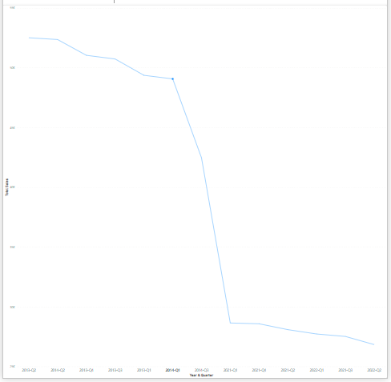
Impact of the risks
Insights
In 2014-Q1, our sales experienced a significant decline, reaching a low point. From 2021-Q1 onwards, there has been a gradual recovery, with sales approaching similar values. However, addressing the earlier decline is crucial, as it poses a potential threat to the sustainability of our company. If left unaddressed, this trend could jeopardize the future of our organization. Therefore, finding solutions to rectify the decline is imperative to ensure the long-term success and viability of our company.

Slide 17
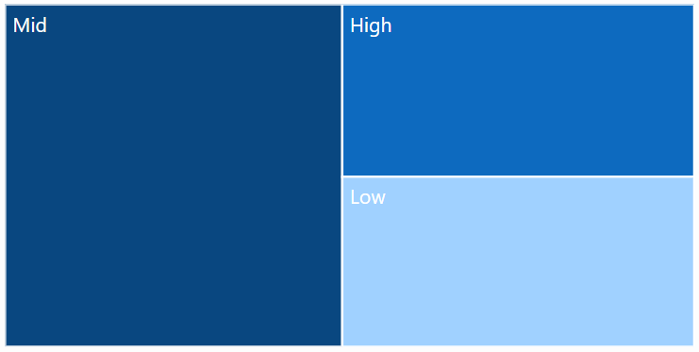
Customer Distribution
Insights
I have introduced a new column to categorize our customers according to their Invoice Amount. It is evident that the majority of our customers fall within the mid-range Invoice Amount category, while the low and high categories exhibit values that are closely aligned.

Slide 18
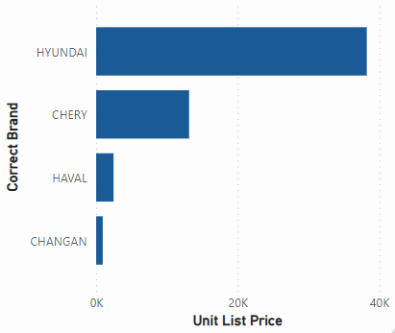
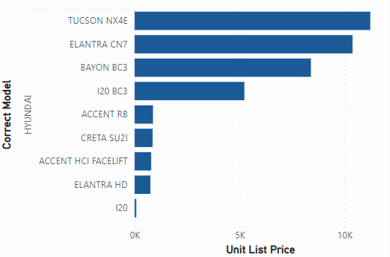
Product Analysis
Insights
The HYUNDAI brand stands out with the highest sales, emphasizing the need for consistent availability to meet customer demand. Following closely is the CHERY brand, which boasts acceptable sales figures. However, brands such as HAVAL and CHANCAN have fewer customers, indicating room for improvement in their market presence.
Upon closer examination of the HYNDAI brand, we find that the TUCSON NX4E model has the highest sales, followed by the ELENTRA CN7.

Slide 19
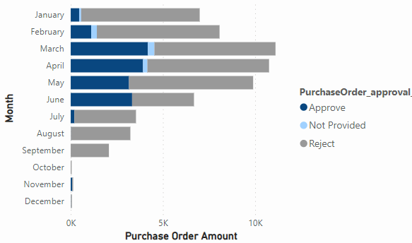
Approval Process Efficiency
Insights
In August and September, we observed a complete rejection of all orders, prompting the need for an investigation into the root cause. Additionally, there is a notable increase in the overall volume of rejected orders. It is imperative to analyze customer behavior to uncover the reasons behind this surge in order rejections. Understanding the factors contributing to the high rejection rate will be essential in addressing and rectifying the situation.

Slide 20
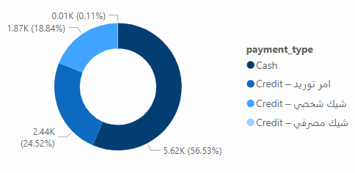
Payment Type Analysis
Insights
The predominant payment method among our customers is cash, constituting 56.53% of transactions. Conversely, the utilization of Credit-شيك مصرفي is relatively rare among our customer base.

Slide 21
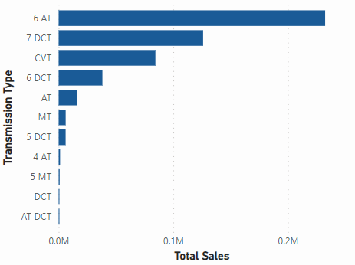
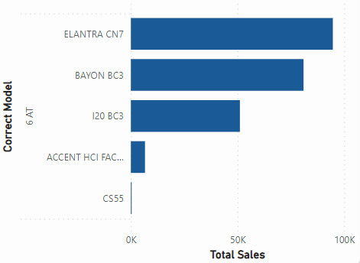
Transmission Type and Sales
Insights
The highest sales amount is attributed to the 6 AT transmission type, with the 7 DCT following closely in second place, and CVT securing the third position. Upon further examination of the 6 AT transmission type.
It is noteworthy that the highest model sales within 6 AT transmission type is associated with the ELENTRA CN7 model.

Slide 22

03
Business-Wide Navigation

Slide 23
$359000
Total Innovice Amount

Slide 24
How can opportunities and sales orders be managed more efficiently to streamline operational processes?
Implement a centralized Customer Relationship Management (CRM) system.
Create Power BI dashboards for real-time visibility into opportunities and sales order status, This enable stakeholders to track progress, identify bottlenecks, and make informed decisions.
Regularly review and update opportunity statuses.
Provide training programs to sales teams to enhance efficiency in managing opportunities.

Slide 25
What measures can be implemented to enhance financial processes, considering the relationships identified between purchase orders, approvals, and payments?
Implement workflow automation tools to streamline and expedite the approval process.
To overcome any bottleneck: Encourage faster payments by offering discounts for early payments.
Improve communication between departments involved in the financial process to reduce delays.
Before taking any action, get a measurement of current financial performance. This baseline is key to assessing whether future efforts to improve financial performance are paying off. Then, collect data during and after any actions are taken.

Slide 26
How can inventory and product management strategies be optimized based on insights derived from move numbers, unit list prices, and product preferences?
Move Number reduced at the end of year.
HUNDAI is the most brand that has highest unit list price, with top 3 models[TUCSON NX4E, ELANTRA CN7, BAYON BC3](Focus marketing efforts on popular products ).
Implement dynamic pricing strategies based on unit list prices and product popularity.
we may need to make sales in other brands specially CHANGAN(Bundle products or offer discounts on less popular items ).
Incorporate customer feedback and preferences into product management decisions.

Slide 27
In what ways can customer engagement and satisfaction be improved, considering operational findings related to wish lists and receipt processing?
Receipt Status is "APP" it has more purchased order amounts.
Regularly monitor customer feedback related to receipts.
When our Product exists in Wish List it provide more sales too but it doesn't has big impact like Receipt Status, suggest (Leverage wish list data for targeted marketing campaigns so we can sale more products from wish list.), also we can Reward customers for wish list creations and purchases this going to make them more careful to but their product in wish list and based on it we can make more correct decisions.

Slide 28

Thanks!

